Slide 1
CDR Policy Compliance XREF Mapping provided by Regional Australia Bank to the CDR Community in August 2020
Document Purpose This document was created to help demonstrate why each element of Regional Australia Bank’s July 2020 CDR Policy was required and how it could be associated with a requirement of the Rules or the Act.
The Policy is available in both interactive and static formats at: https://www.regionalaustraliabank.com.au/our-cdr-policy
How to use this document This mapping has been done against the static version of the CDR policy. You may wish to do something similar to help communicate with your Compliance and UX Design teams.
On its own, this document will not demonstrate compliance – for that we suggest using it in conjunction with the CDR Policy XREF Requirements Template.
These are relevant clauses from The Rules (February 2020)
These are relevant clauses from The Act
Remember: Some rules don’t apply to this CDR policy design because they are for Data Holders. This version of the CDR policy was designed to meet requirements of a Data Recipient.
Disclaimer: The information in this document is provided “as is” with no guarantee of completeness

Slide 2
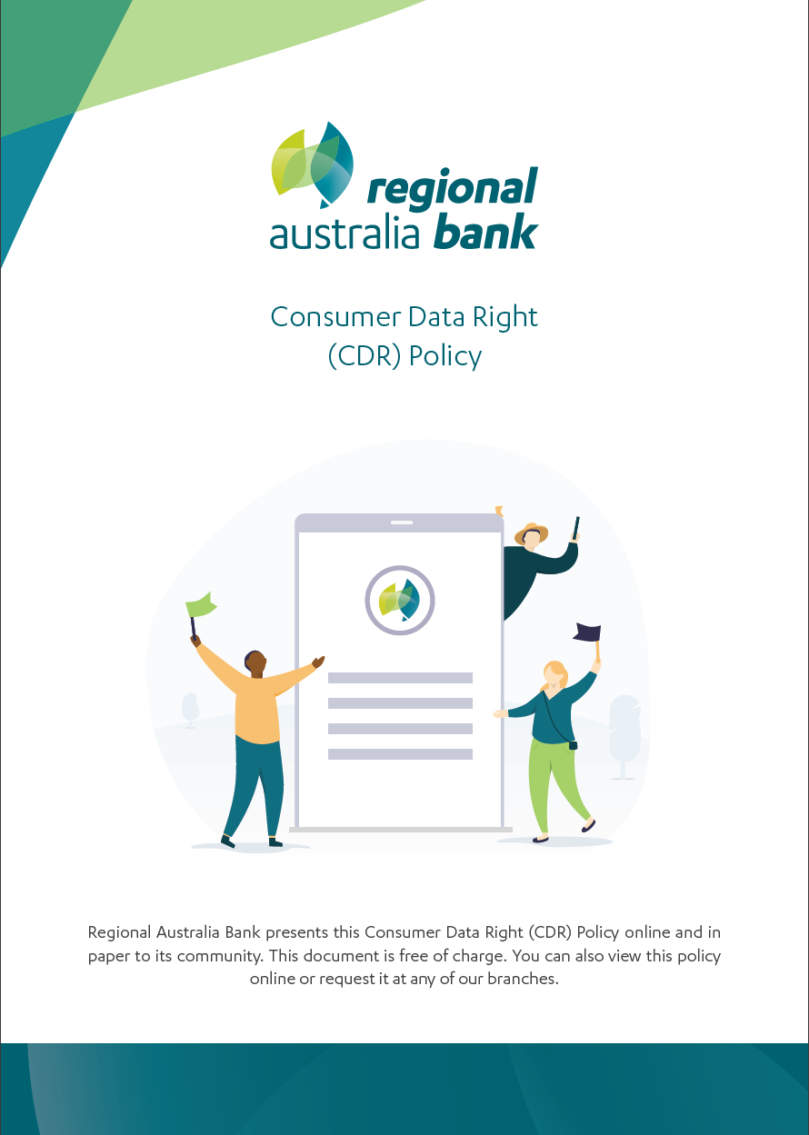
Rule 7.2(2)
For paragraph 56ED(3)(b) of the Act, a CDR entity's CDR policy must be in the form of a document that is distinct from any of the CDR entity's privacy policies.
Act 56ED(3)(a)
The CDR entity must have and maintain a clearly expressed and up-to-date policy that is about the CDR entity’s management of CDR data; and
Act 56ED(3)(b)
The CDR entity must have and maintain a clearly expressed and up-to-date policy that is is in a form approved in accordance with the consumer data rules;
Act 56ED(7)(b)
in accordance with the consumer data rules
Act 56ED(8)
If a copy of the CDR entity’s policy is requested by a CDR consumer for the CDR data, the CDR entity must give the CDR consumer a copy in accordance with the consumer data rules.
Rule 7.2(8)
For paragraph 56ED(7)(b) of the Act, a CDR participant must make its CDR policy readily available through each online service by means of which the CDR participant ordinarily deals with CDR consumers.
Rule 7.2(9)
For subsection 56ED(8) of the Act, if a copy of a the CDR participant's policy is requested by a CDR consumer, the participant must give the CDR consumer a copy: (a) electronically; or
(b) In hard copy;
Act 56ED(7)(a)
free of charge;

Slide 3
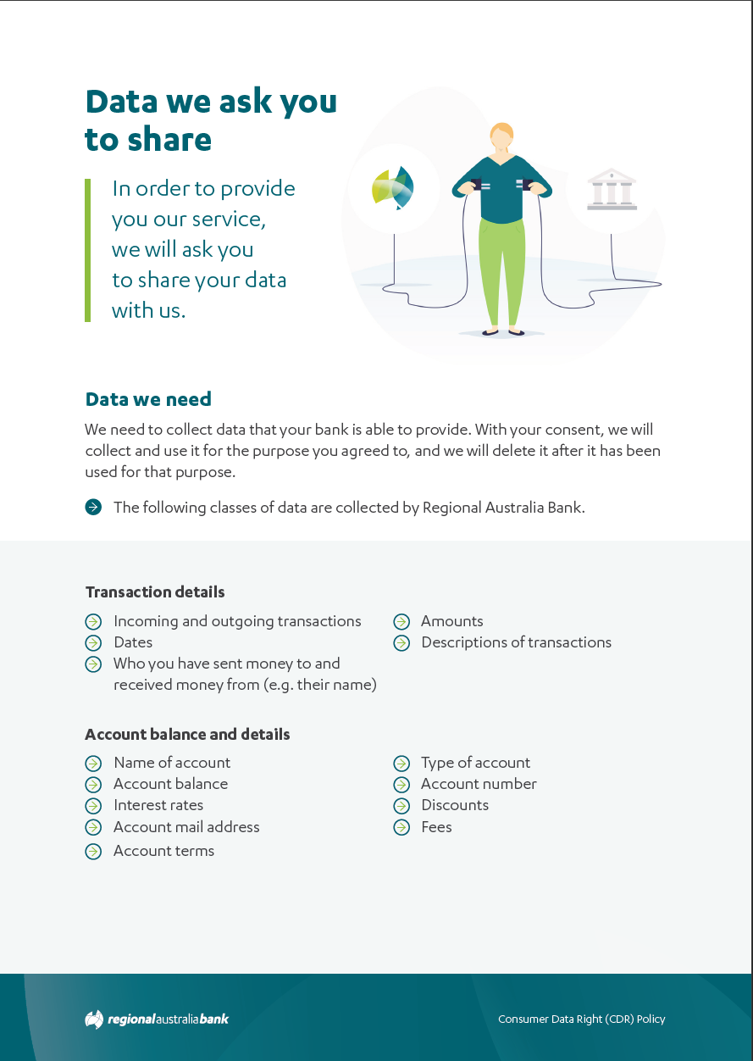
Act 56ED(5)(b)
the purposes for which the CDR entity may collect, hold, use or disclose such CDR data with the consent of a CDR consumer for the CDR data;
Rule 7.2(4)(f)(i)
Include the following information about deletion of redundant CDR data:
when it deletes redundant data;
Act 56ED(5)(a)
the classes of CDR data held by (or on behalf of) the CDR entity as an accredited data recipient, and how such CDR data is held;

Slide 4
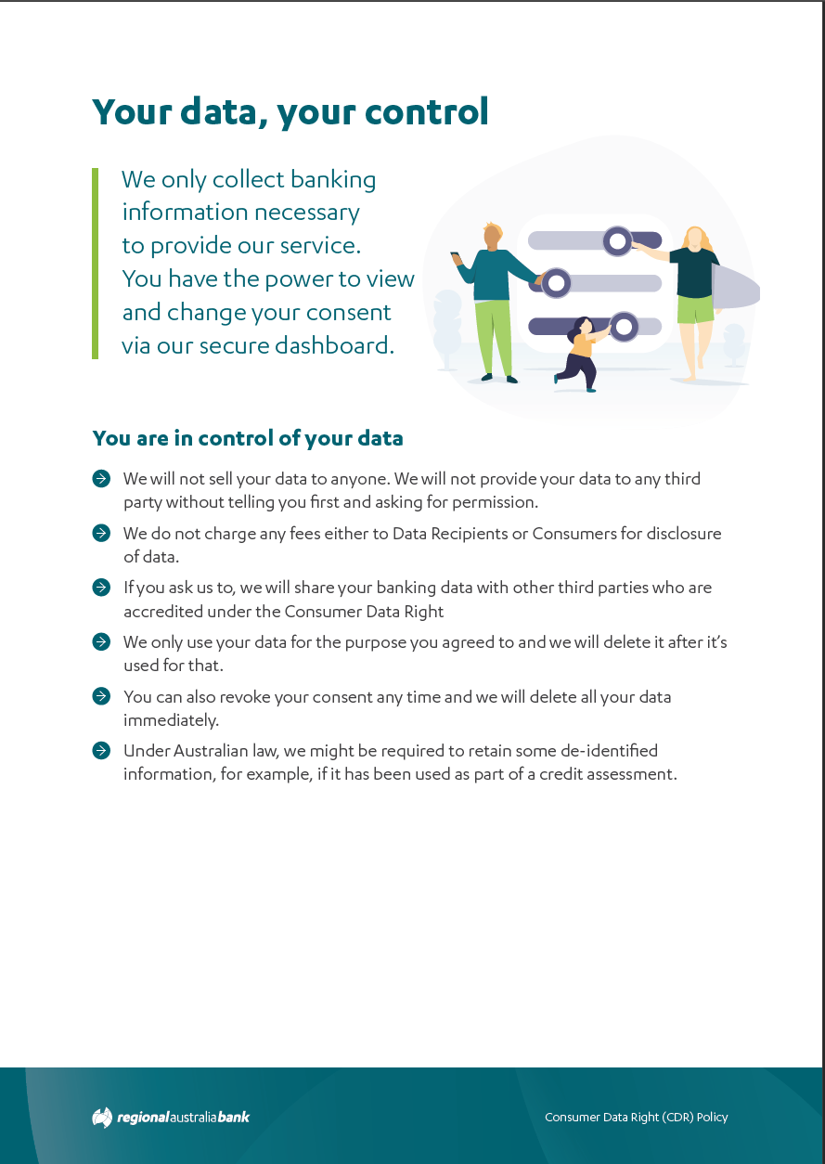
Act 56ED(5)(b)
the purposes for which the CDR entity may collect, hold, use or disclose such CDR data with the consent of a CDR consumer for the CDR data;
Rule 7.2(4)(f)(i)
Include the following information about deletion of redundant CDR data:
when it deletes redundant data;
Rule 7.2(4)(f)(ii)
Include the following information about deletion of redundant CDR data:
how a CDR consumer may elect for this to happen;
Rule 7.2(4)(e)(i)
if applicable-include the following information about de-identification of CDR data that is not redundant data:
how the accredited person uses CDR data that has been de-identified in accordance with the CDR data de-identification process to provide goods or services to CDR consumers;

Slide 5
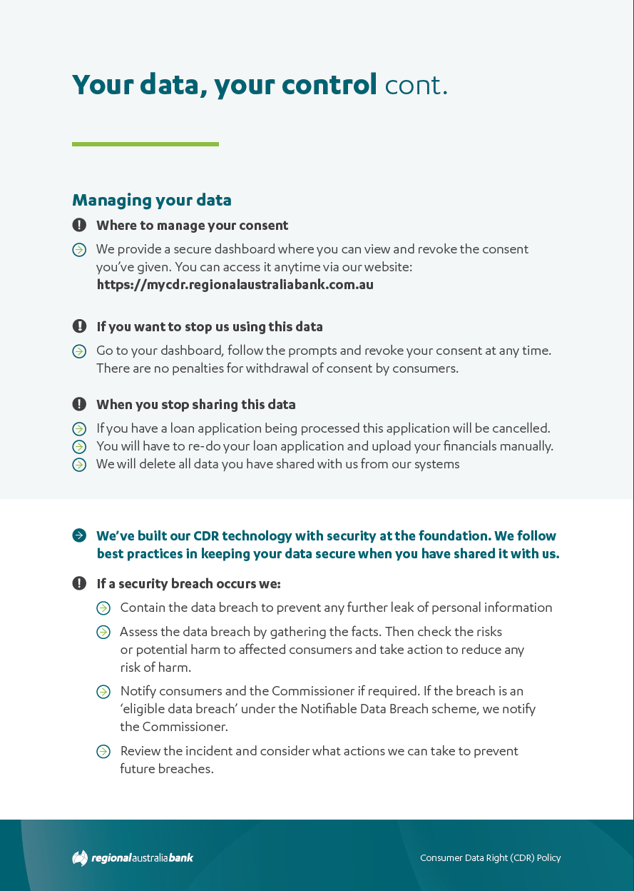
Rule 7.2(4)(h)(i) and (ii)
include the following information about the CDR consumer's election to delete their CDR data:
information about how the election operates and its effect;
information about how CDR consumers can exercise the election.
Rule 7.2(4)(f)(ii)
Include the following information about deletion of redundant CDR data:
how a CDR consumer may elect for this to happen;
Rule 7.2(4)(a)
include a statement indicating the consequences to the CDR consumer if they withdraw a consent to collect and use CDR data; and
Rule 7.2(4)(f)(iii)
Include the following information about deletion of redundant CDR data:
how it deletes redundant data; and
Rule 7.2(4)(f)(i)
Include the following information about deletion of redundant CDR data:
when it deletes redundant data;
Act 56ED(5)(h)
the events about which the CDR entity will notify the CDR consumers of such CDR data;

Slide 6
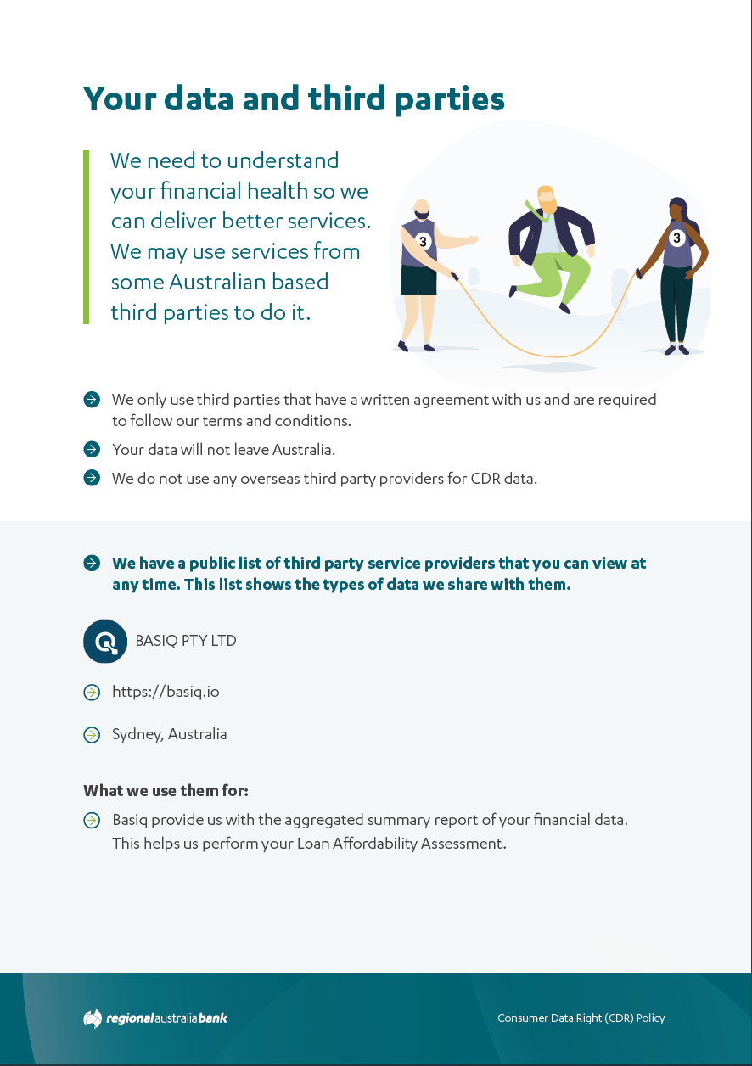
Rule 7.2(5)(b)
if the accredited person ordinarily discloses (by sale or otherwise) de-identified data to one or more other persons:
Act 56ED(5)(b)
the purposes for which the CDR entity may collect, hold, use or disclose such CDR data with the consent of a CDR consumer for the CDR data;
Rule 7.2(4)(d)
if the accredited data recipient is likely to disclose CDR data of a kind referred to in subsection 56ED(5) of the Act to such a service provider that:
is based overseas; and
is not an accredited person;
include the countries in which such persons are likely to be based if it is practicable to specify those countries in the policy; and
Act 56ED(5)(g)
the circumstances in which the CDR entity may disclose such CDR data to a person who is not an accredited person;
Rule 7.2(4)(b)
Include a list of the outsourced service providers (whether based in Australia or based overseas, and whether or not any is an accredited person); and
Act 56ED(5)(e)
whether the CDR entity is likely to disclose such CDR data to accredited persons who are based overseas;
Compliance Note:
We’re also adding a link to the OSP page which contains even more information
https://www.regionalaustraliabank.com.au/personal/support/outsourced-service-providers
Act 56ED(5)(b)
the purposes for which the CDR entity may collect, hold, use or disclose such CDR data with the consent of a CDR consumer for the CDR data;
Rule 7.2(4)(c)
for each such service provider-include:
the nature of the services it provides; and the CDR data or classes of CDR data that may be disclosed to it; and

Slide 7
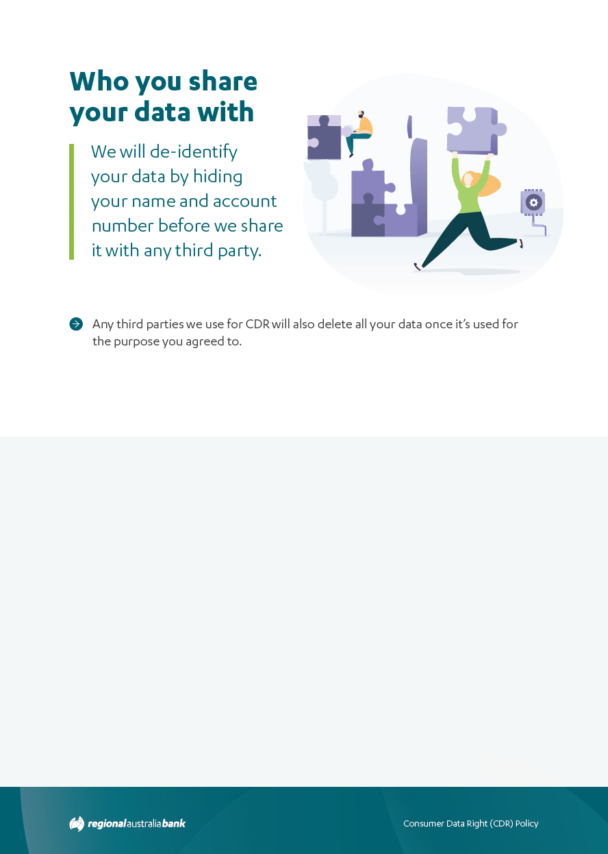
Rule 7.2(4)(e)(i)
if applicable-include the following information about de-identification of CDR data that is not redundant data:
how the accredited person uses CDR data that has been de-identified in accordance with the CDR data de-identification process to provide goods or services to CDR consumers;
Rule 7.2(5)(a)
how the accredited person de-identifies CDR data, including a description of techniques that it uses to de-identify data; and
Rule 7.2(4)(f)(i)
Include the following information about deletion of redundant CDR data:
when it deletes redundant data;
Act 56ED(5)(i)
the circumstances in which the CDR entity must delete or de-identify such CDR data in accordance with a request given by a CDR consumer for the CDR data under the consumer data rules.

Slide 8
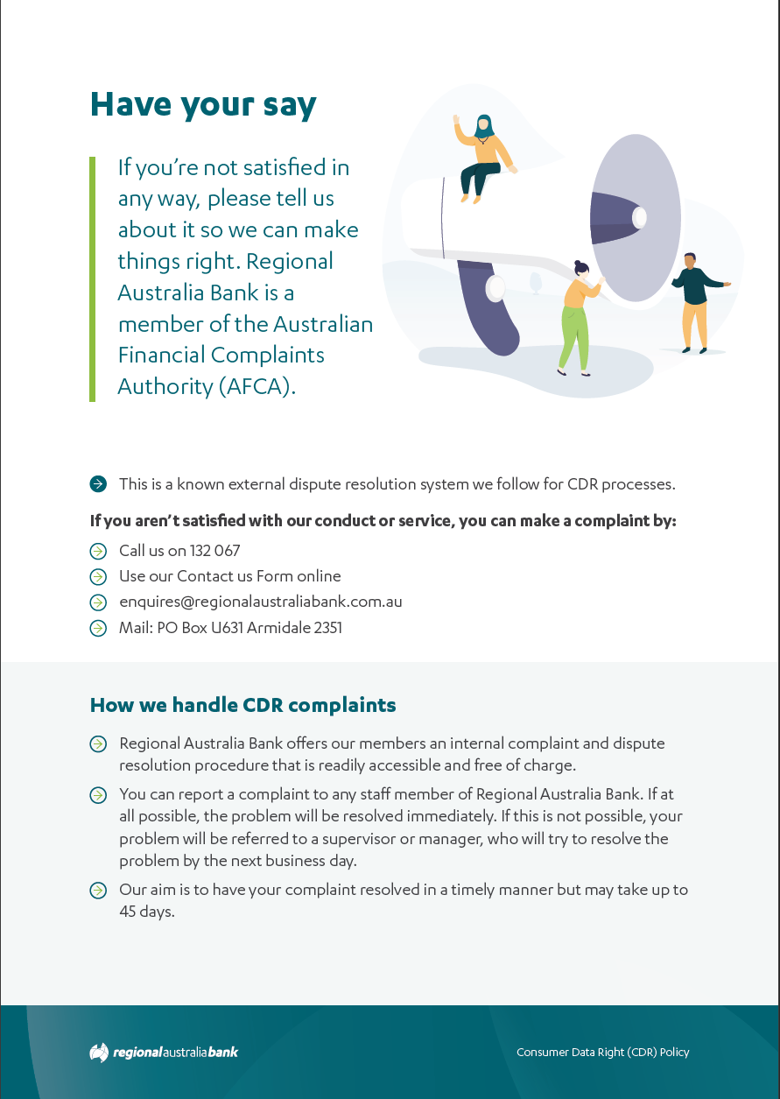
Act 56ED(5)(c)
how a CDR consumer for such CDR data may access the CDR data and seek the correction of the CDR data;
Act 56ED(5)(d)
how a CDR consumer for such CDR data may complain about a failure of the CDR entity to comply with this Part or the consumer data rules, and how the CDR entity will deal with such a complaint;
Rule 7.2(6)(a) and (b)
where a CDR consumer complaint can be made; how a CDR consumer complaint can be made;
Rule 7.2(6)(f)
the participant's process for handling CDR consumer complaints;
Rule 7.2(6)(g)
time periods associated with various stages in the CDR consumer complaint process;

Slide 9
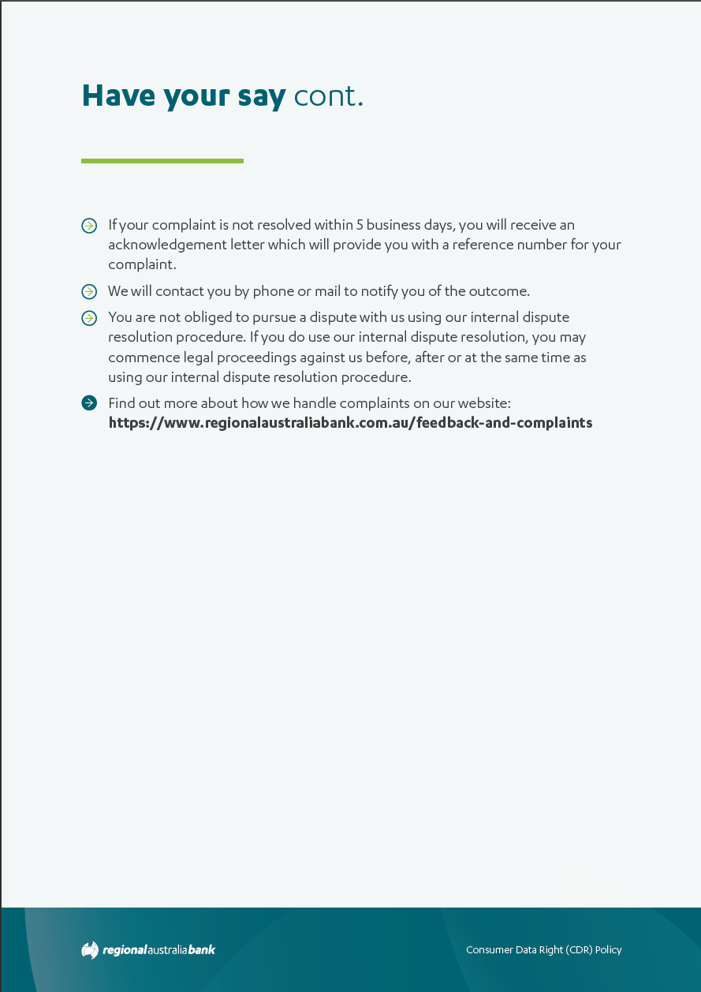
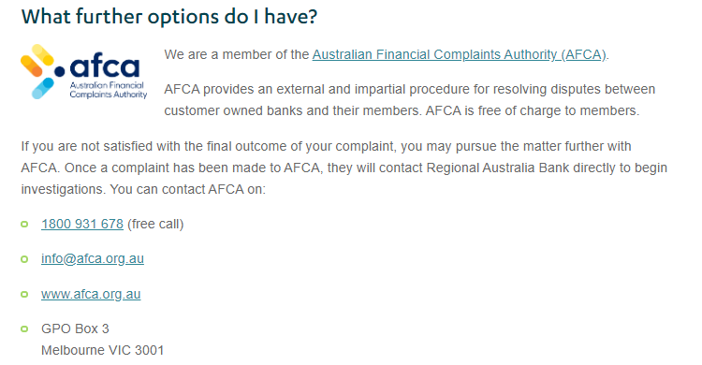
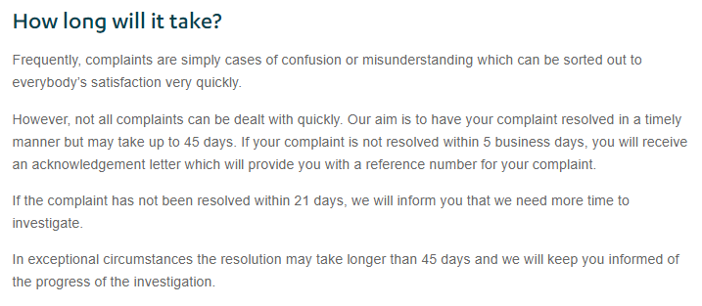
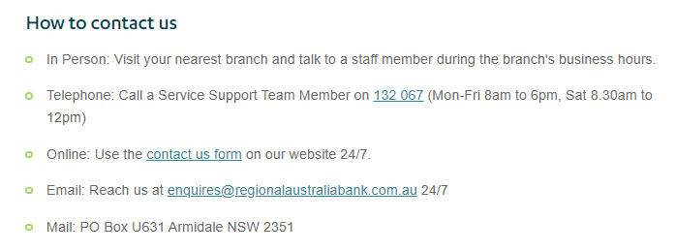
Rule 7.2(6)(d)
when acknowledgement of a CDR consumer complaint can be expected;
Rule 7.2(6)(f)
the participant's process for handling CDR consumer complaints;
Rule 7.2(6)(h) options for redress;
Rule 7.2(6)(i) options for review;
Rule 7.2(6)(g)
time periods associated with various stages in the CDR consumer complaint process;
Rule 7.2(6)(c)
when a CDR consumer complaint can be made;
Rule 7.2(6)(e)
what information is required to be provided by the complainant;

